Slide 1
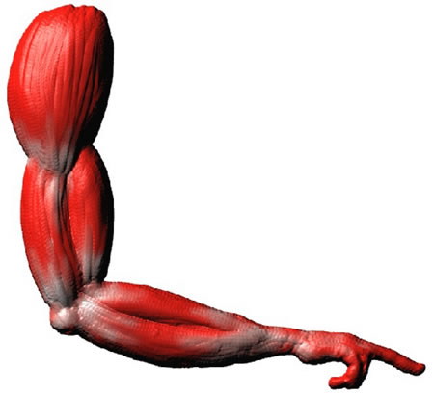
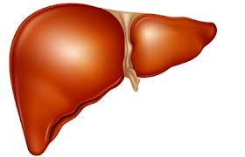
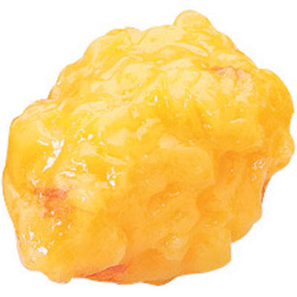
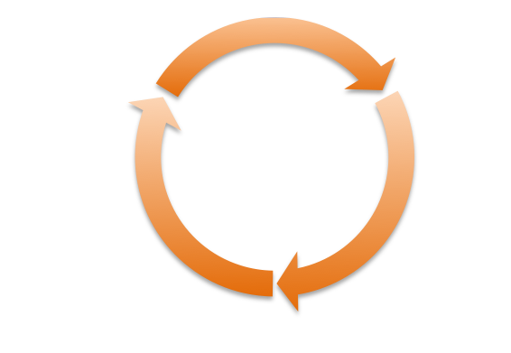
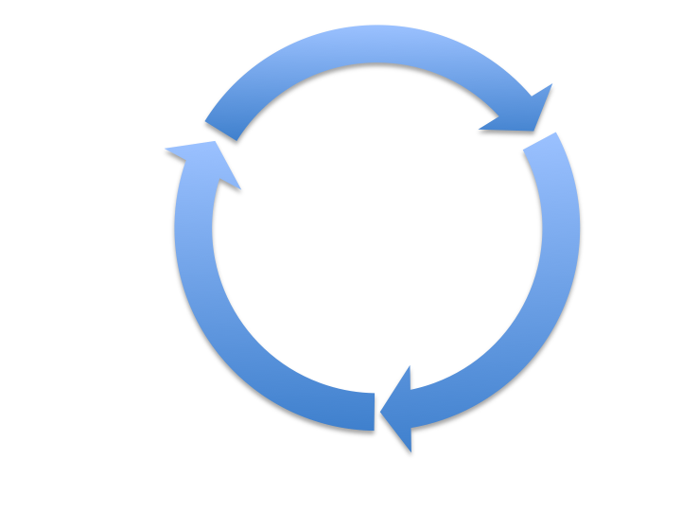
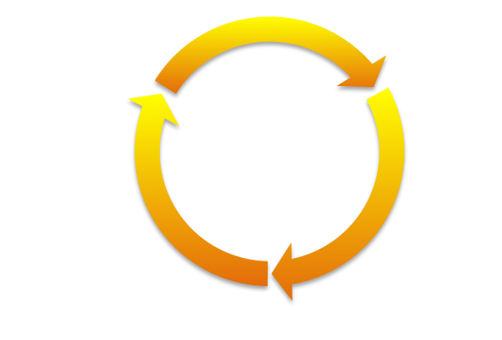
Fill in all the arrows
Glycogen
Glucose
Glucose
Triglyceride
Adipose
Glycogen
Acetyl CoA
Lipogenesis
Protein
Citric Acid
Cycle
Lipolysis
Amino acids
Name__________________________________Date_____________________Section

Slide 2
You have just eaten a milkshake and three cookies – what happens?
Glycogen
Glucose
Glucose
Triglyceride
Adipose
Glycogen
Acetyl CoA
Lipogenesis
Protein
Citric Acid
Cycle
Amino acids

Slide 3
You have just eaten a milkshake and three cookies – what happens?
Glycogen
Glucose
Protein
Glucose
Triglyceride
Adipose
Glycogen
Acetyl CoA
Lipogenesis
Citric Acid
Cycle
Amino acids

Slide 4
You have just finished a 5 mile run – what happens?
Glycogen
Glucose
Glucose
Triglyceride
Adipose
Protein
Glycogen
Acetyl CoA
Citric Acid
Cycle
Amino acids
Lipolysis

Slide 5
You have just finished a 5 mile run – what happens?
Glycogen
Glucose
Glucose
Triglyceride
Adipose
Protein
Glycogen
Acetyl CoA
Citric Acid
Cycle
Amino acids
Lipolysis

Slide 6
A person with diabetes eats macaroni and cheese – what happens?
Glycogen
Glucose
Glucose
Triglyceride
Adipose
Protein
Glycogen
Acetyl CoA
Lipogenesis
Citric Acid
Cycle
Amino acids
Lipolysis

Slide 7
A person with diabetes eats macaroni and cheese – what happens?
Glycogen
Glucose
Glucose
Triglyceride
Adipose
Protein
Glycogen
Acetyl CoA
Lipogenesis
Citric Acid
Cycle
Amino acids
Lipolysis

